Slide 1
Vehicle Routing Problem
VRP

Slide 2
Out Lines
INTRODUCTION
VRP && CVRP
Data Configuration
Define the distance call back
Add a distance dimension
Add the capacity constraints
Tools
Add the solution printer
Complete Programme

Slide 3

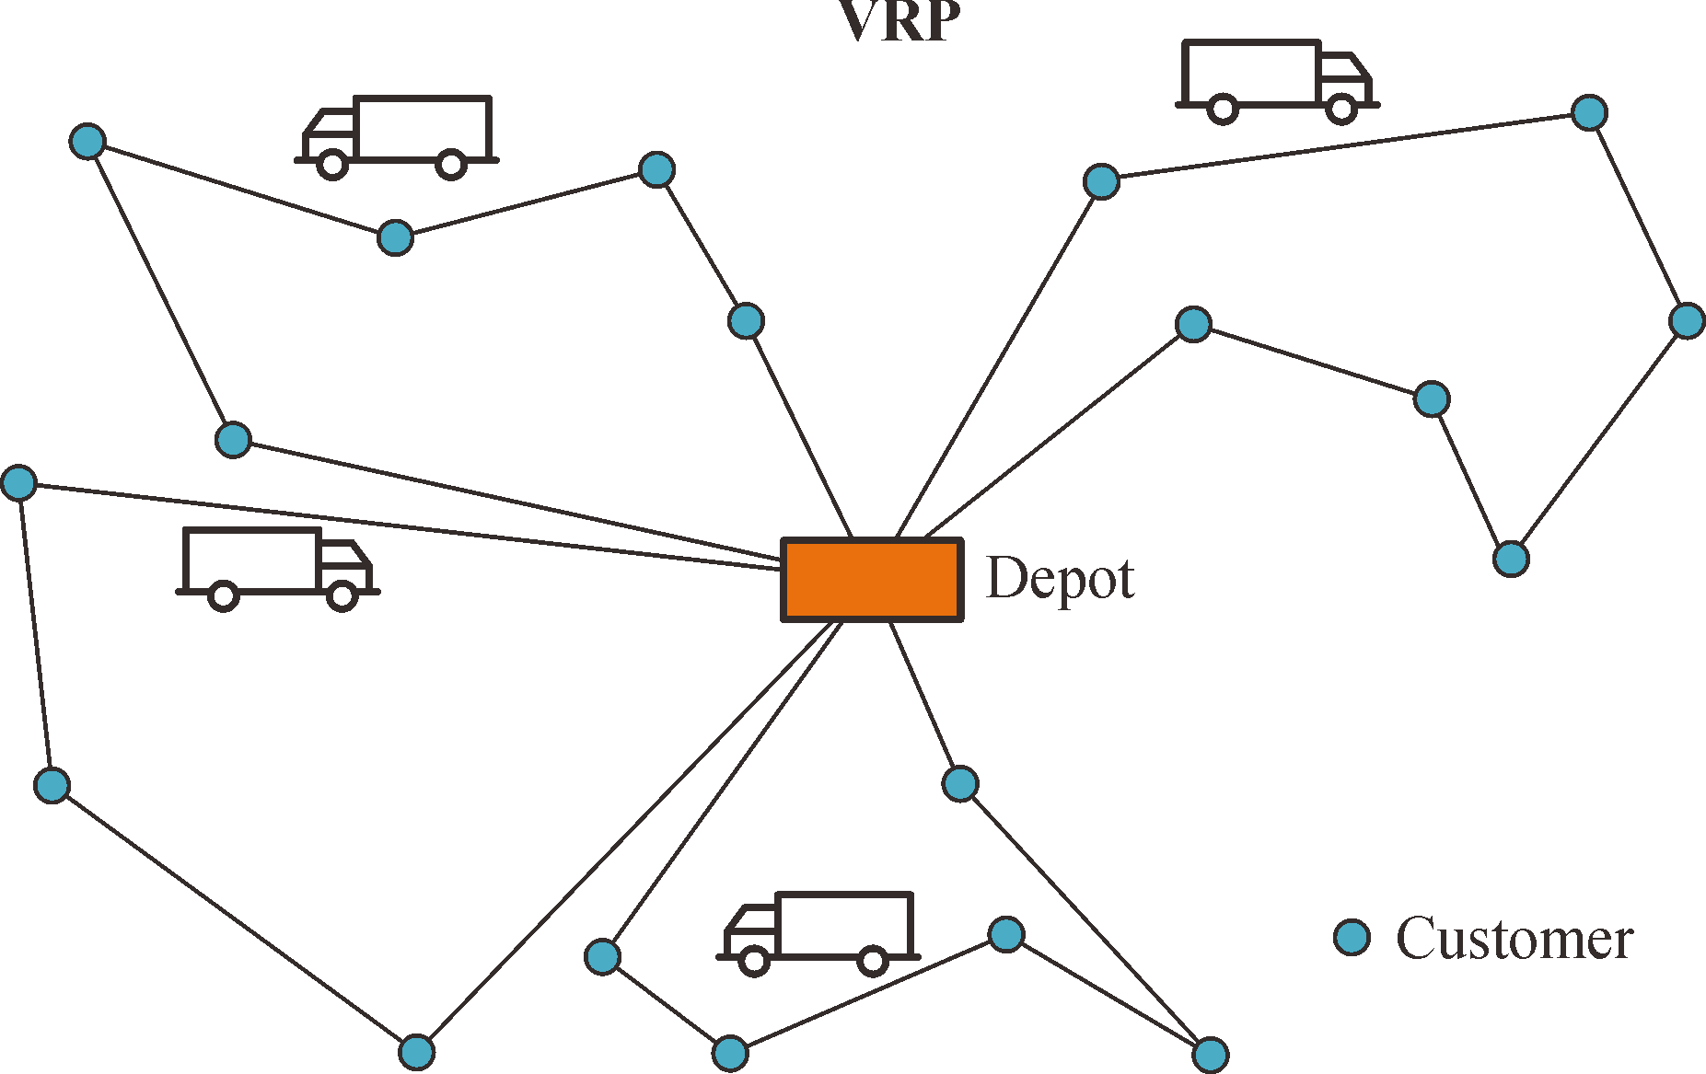
introduction
A better way to define optimal routes is to minimize the length of the longest single route among all vehicles. This is the right definition if the goal is to complete all deliveries as soon as possible‏.
what do we mean by "optimal routes" for a VRP?

Slide 4
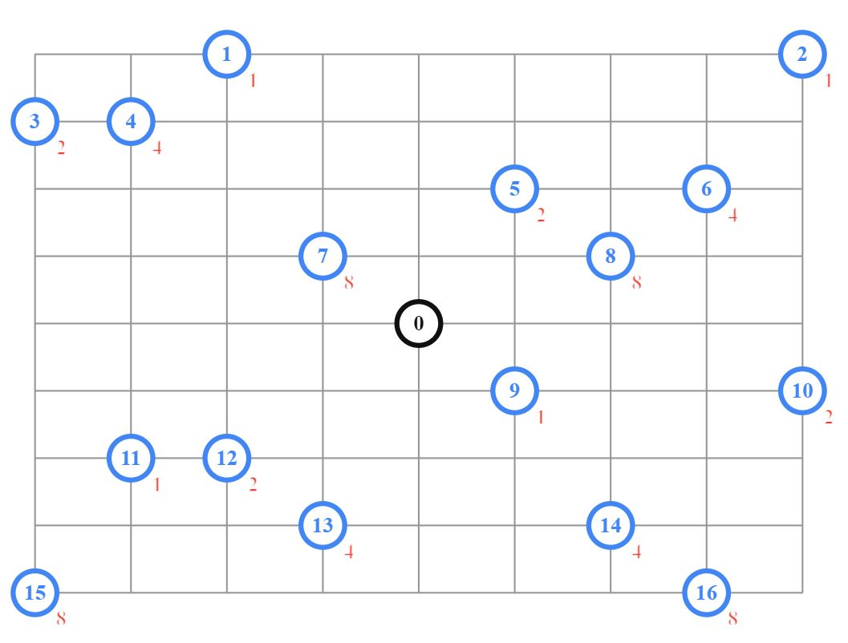
VRP
One answer is the routes with the least total distance. However, if there are no other constraints, the optimal solution is to assign just one vehicle to visit all locations, and find the shortest route for that vehicle
In the Vehicle Routing Problem
(VRP)
the goal is to find optimal routes for multiple vehicles visiting a set of locations.

Slide 5
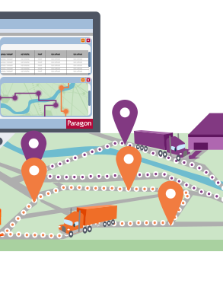
The capacitated vehicle routing problem (CVRP)
is a VRP in which vehicles with limited carrying capacity need to pick up or deliver items at various locations.
The items have a quantity, such as weight or volume, and the vehicles have a maximum capacity that they can carry.
The problem is to find an assignment of routes to vehicles that has the shortest total distance, and such that the total amount a vehicle is carrying never exceeds its capacity.

Slide 6
Data Configuration
The data consists of:
distance_matrix: An array of distances between locations on meters.
num_locations: The number of locations.
num_vehicles: The number of vehicles in the fleet.
depot: The index of the depot, the location where all vehicles start and end their routes.
Demands: Each location has a demand corresponding to the quantity—for example, weight or volume—of the item to be picked up.
Capacities: Each vehicle has a capacity: the maximum quantity that the vehicle can hold. As a vehicle travels along its route, the total quantity of the items it is carrying can never exceed its capacity.

Slide 7
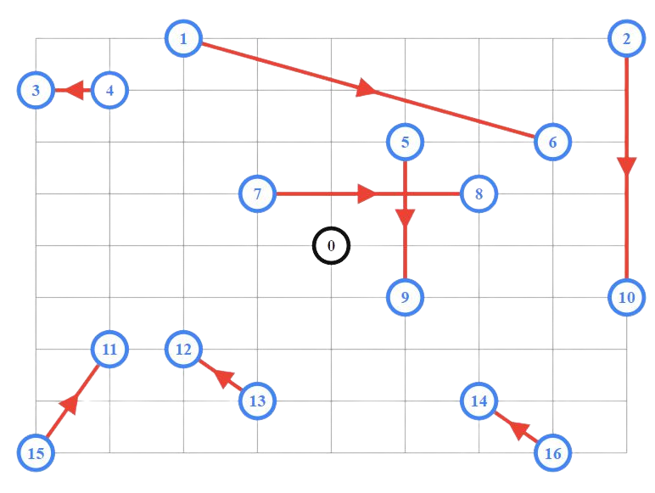
Define the distance call back
creates the distance call back, which returns the distances between locations, and passes it to the solver. It also sets the arc costs, which define the cost of travel

Slide 8
Add a distance dimension
To solve this VRP, you need to create a distance dimension, which computes the cumulative distance traveled by each vehicle along its route. You can then set a cost proportional to the maximum of the total distances along each route. Routing programs use dimensions to keep track of quantities that accumulate over a vehicle's route.

Slide 9
Add the capacity constraints
In addition to the distance callback, the solver also requires a demand callback, which returns the demand at each location, and a dimension for the capacity constraints.
Unlike the distance callback, which takes a pair of locations as inputs, the demand callback only depends on the location (from_node) of the delivery.

Slide 10
Tools
Ortools library
Google colab
Manhattan distance

Slide 11
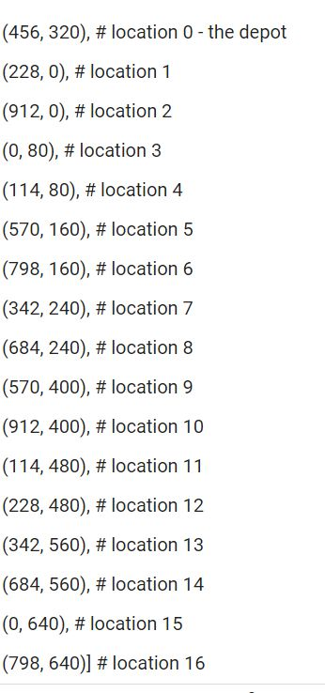
how we get there!!
Manhattan distance
he main purpose of showing the location coordinates and the city diagram in this and other examples is to provide a visual display of the problem and its solution. But this is not essential for solving a VRP. For convenience in setting up the problem, the distances between locations are calculated using Manhattan distance, in which the distance between two points, (x1, y1) and (x2, y2) is defined to be |x1 - x2| + |y1 - y2|. However, there is no special reason to use this definition. You can use whatever method is best suited to your problem to calculate distances.

Slide 12
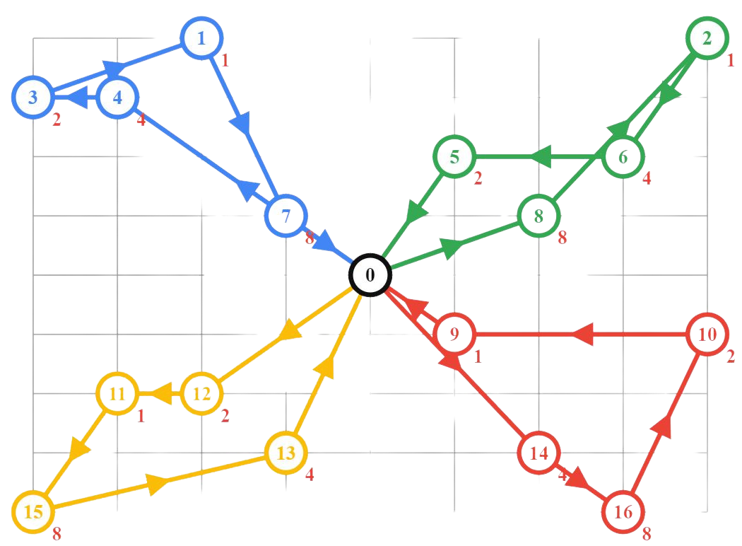
Add the solution printer
The locations in the routes are denoted by their indices in the locations list. All routes begin and end at the depot (0).The diagram below shows the assigned routes, in which the location indices have been converted to the corresponding x-y coordinates.
For each location on a route, the output shows: The index of the location.
The total load carried by the vehicle when it departs the location.
The routes are shown below.

Slide 13
The complete programs for the capacitated vehicle routing problem are shown below.
Complete Programme
https://github.com/Mohamed-sherif24/AI-Project-AMA954-team
www.github.com

Slide 14



meet our team
Ahmed Ali
Mohamed sherif
Abdelkhalek mohamed
221101004
221101055
221101029

Slide 15
thank you
https://github.com/Mohamed-sherif24/AI-Project-AMA954-team www.GETHUB.com

